Slide 1

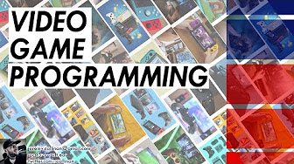






GAME Design & Programming
4/8/2022

Slide 2
Agenda
CIS&T @ Pitt-Bradford
GAME DESIGN DEGREES + CERTIFICATIONS
FUN STUFF TO CHECK OUT!
https://sites.pitt.edu/~jpcst52/
https://jcallinan.github.io/

Slide 3
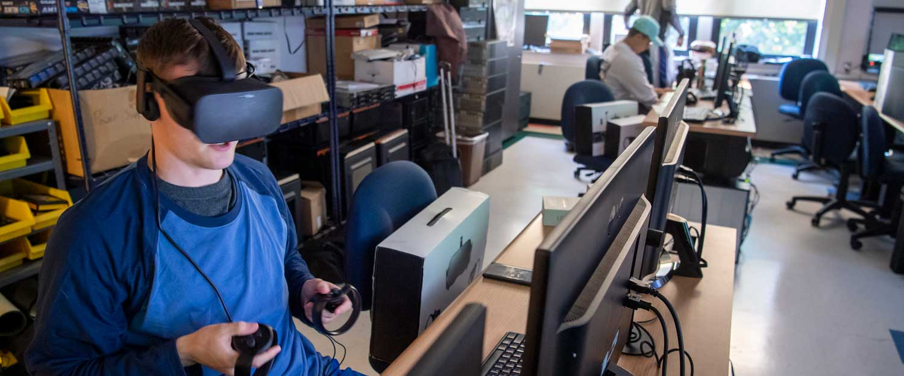
CIS&T @ Pitt-Bradford
Job titles:
Software developer
Operations engineer
Software support analyst
IT consultant
Systems administrator
Programmer
Clinical systems analyst
Numerical control programmer
IT manager
Technical engineer
Employers:
Amazon
Bayer Pharmaceuticals
Yahoo
Cargill
NexGen Technologies
iGlobal
Zippo Manufacturing Co.
Verizon Media Services
IBM
Deloitte
https://www.upb.pitt.edu/academics/computer-information-systems-and-technology-bs

Slide 4


George B. Duke Engineering and Information Technologies Building
A circuit lab with bench space for soldering, function generators, analog and digital microcontrollers, spectrum analyzer, and oscilloscopes.
A measurements lab where students will be able to work with sensors and automation in a space containing programmable logic controllers, wireless sensing hardware, ultrasonic flaw detectors, and more.
A machine shop with computer-controlled plasma cutter, CNC milling machines and lathes, variable speed drill presses, band saws, machine presses, disc and belt grinders, welders, and rapid prototype machines. Students will be able to create prototypes, then test them in the strength and materials or fluid dynamics lab.
A strength and materials lab, where students can test, measure, and destroy their creations by pulling, pushing, and hitting them with a compression/tension tester and a dynamic fatigue tester as well as testers for impact, hardness, and torque.
A fluid dynamics lab with a wind tunnel, table-top fluid process automation system, Rankine cycler and more.
A maker space, featuring 3D printing and scanning for rapid prototyping to be shared with the information technology program.
An expanded Systems, Networks and Projects Lab – known as a SNAP Lab – to enable students to practice setting up small computer and data operation centers.
A FLEX Lab to give students the space they need to gather data, perform analyses, and creative virtual and scaled prototypes for new products and services.
A virtual reality lab equipped with a presentation platform and a huge screen on which students can present projects as well as an 18-foot-high ceiling to allow for hanging sensors and cameras.

Slide 5

GAME DESIGN DEGREES + CERTIFICATIONS
Unity https://unity.com/products/unity-certifications
https://unity.com/products/unity-certifications/professional-programmer
https://executive-ed.xpro.mit.edu/virtual-reality-augmented-reality Unreal Engine https://www.unrealengine.com/en-US/training
https://www.unrealengine.com/en-US/onlinelearning-courses Blender
https://www.courseduck.com/programming/blender/
https://studio.blender.org/training/ Maya
https://www.skillshare.com/browse/maya

Slide 6
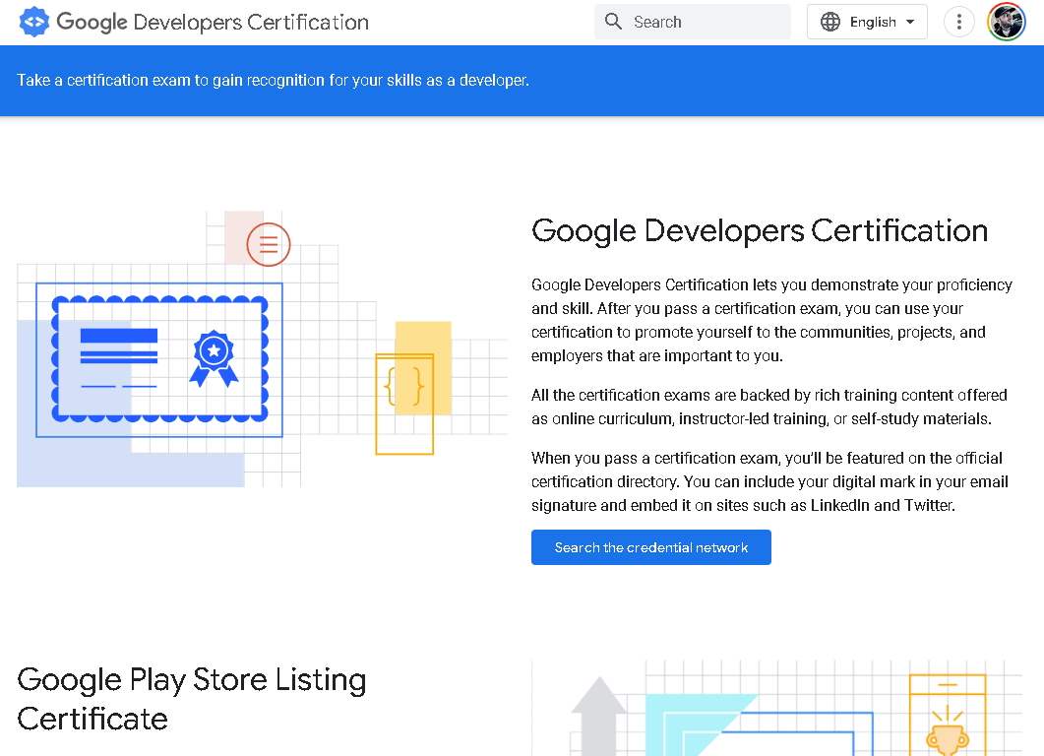
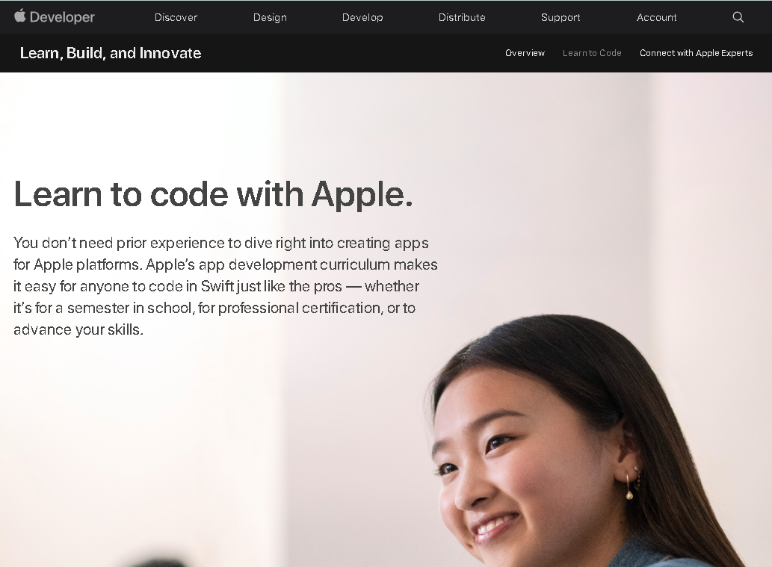

OTHER IMPORTANT CERTS / THINGS TO DO
GitHub
http://github.com/ http://github.com/jcallinan/
Google Developers - https://developers.google.com/certification
Google Career certificates -
https://grow.google/certificates/
Apple Developer Certification - https://developer.apple.com/learn/curriculum/ Good places to learn in general
Udemy - https://www.udemy.com/
LinkedIn Learning - https://www.linkedin.com/learning/
PS: U of People - https://www.uopeople.edu/
PS GitHub Pages - https://jcallinan.github.io/
PPS https://sites.pitt.edu/~jpcst52/

Slide 7


2 IMPORTANT ITEMS FOR PROGRAMMERS
Cracking the Coding Interview - https://www.amazon.com/Cracking-Coding-Interview-Programming-Questions/dp/0984782850
https://leetcode.com/

Slide 8


SYLLABUS EXAMPLES

Slide 9


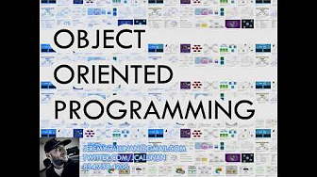
PLAYLISTS ON YOUTUBE
Video Game Development - https://www.youtube.com/playlist?list=PLh4Af_PUe6Q-sZeDXvqJVnxhYtjKtooSe
Mobile Application Programming - https://www.youtube.com/playlist?list=PLh4Af_PUe6Q8m95kn0kfyNeac2-vF1cOB
Object Orientated Programming- https://www.youtube.com/playlist?list=PLh4Af_PUe6Q8RfDGh5w8DPv3QCj5KljXH
Video Game Programming - https://www.youtube.com/playlist?list=PLh4Af_PUe6Q-EvdztXvNO7YddfShi8bK3
Virtual Reality - https://www.youtube.com/playlist?list=PLh4Af_PUe6Q_E0SshiXSN-XgXOeT_dxqL
About VR - https://www.youtube.com/playlist?list=PLh4Af_PUe6Q9-OR5gGJqEKGc5I-O--YA4

Slide 10


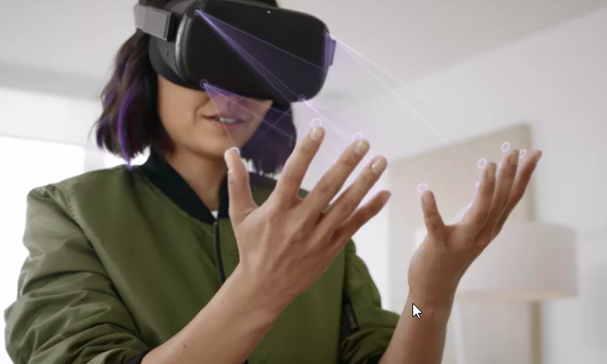

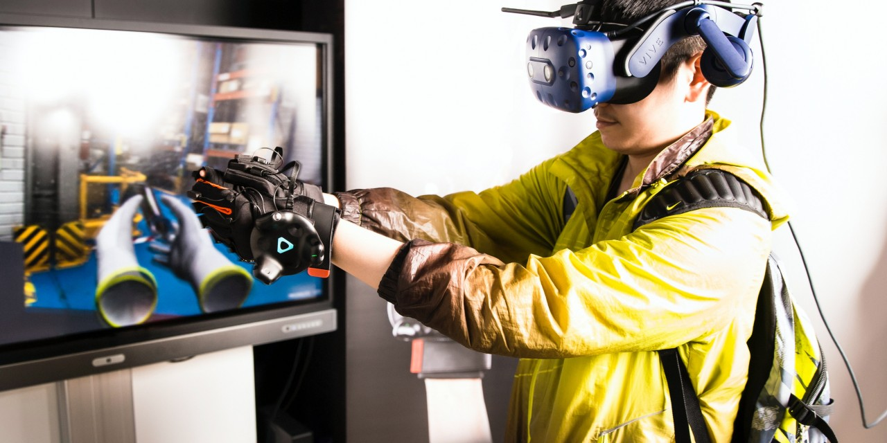

FUN STUFF TO CHECK OUT!
Virtual Reality
Meta Quest
Oculus Rift
HC Vive
Windows Mixed Reality
Unity
Standard Assets Project
Other Tutorials

